Slide 1



UFO Sightings
Team Tenacious:
Abi Chambers
Alejandro Perez
Carlos De La Rosa
Ann Ly

Slide 2
Topic: UFO Sightings
We selected the topic of UFO sightings because of the perspective-broadening nature of the topic and the extensive data available. Sightings of unidentifiable objects have been reported as early as the 1940’s. The first well known UFO sighting occurred in 1947 near Mount Rainier in Washington (Shostak, S. (2023, April 21). Unidentified flying object. Britannica https://www.britannica.com/topic/unidentified-flying-object). The topic raises great questions about why so many people have reported similar sightings around the world.
LINKS TO SIMILAR EDAS
• https://www.kaggle.com/code/sagarsy2050/ufo-sightings/notebook
• https://towardsdatascience.com/are-we-alone-in-the-universe-data-analysis-and-data-visualization-of-ufosightings-with-r-42d0798679c3
• https://www.cs.ubc.ca/~tmm/courses/547-17F/projects/hayley-theodore/report.pdf
• https://www.kaggle.com/code/moosecat/world-ufo-sightings
• https://www.kaggle.com/code/brsdincer/meteorite-landings-analysis-all-eda-theory

Slide 3
UFO Sighting Dataset
Dataset: UFO Sightings around the world | Kaggle
This is a 13.71MB CSV dataset. It is comprised of eleven columns and over 80,000 rows. The data contained therein includes dates and times of the sightings spanning over 100 years, as well as the date the sighting was documented, city/state/country locations as well as latitude and longitude information of sightings, the shape of the unidentified object seen, the length of the encounter, and a text description.

Slide 4
Color Palette

Slide 5
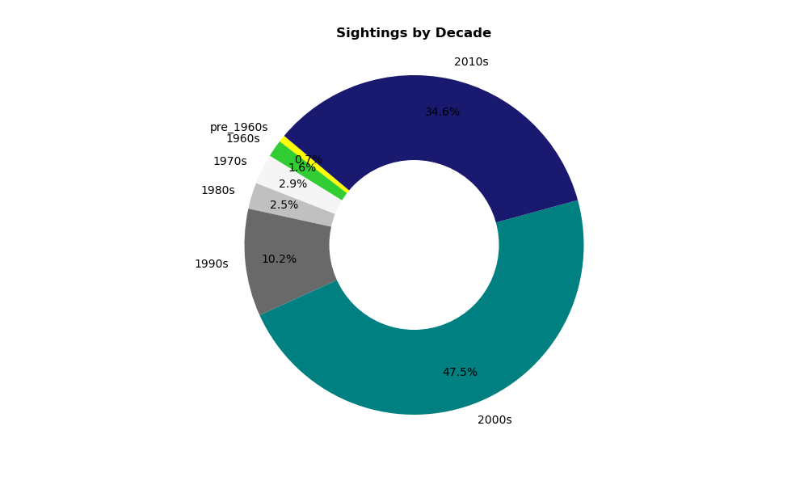

Slide 6
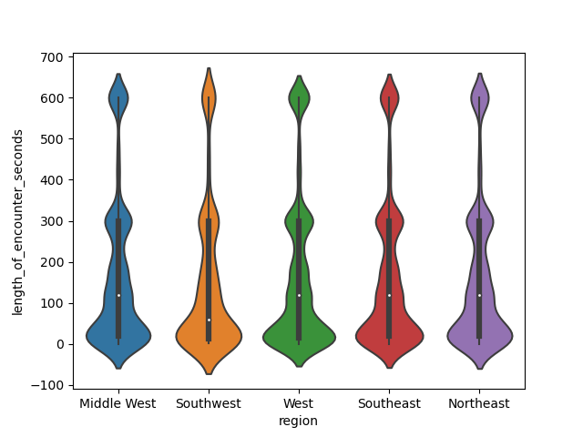

Slide 7
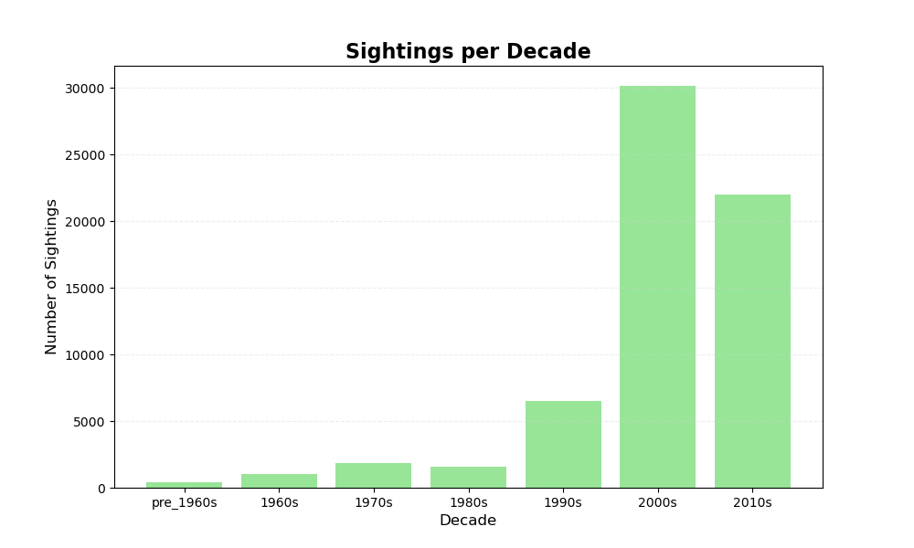

Slide 8
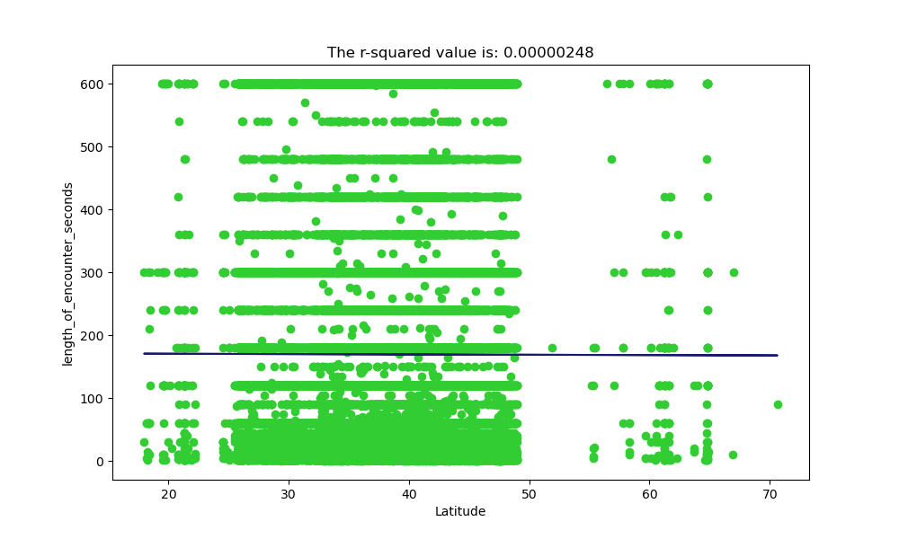

Slide 9
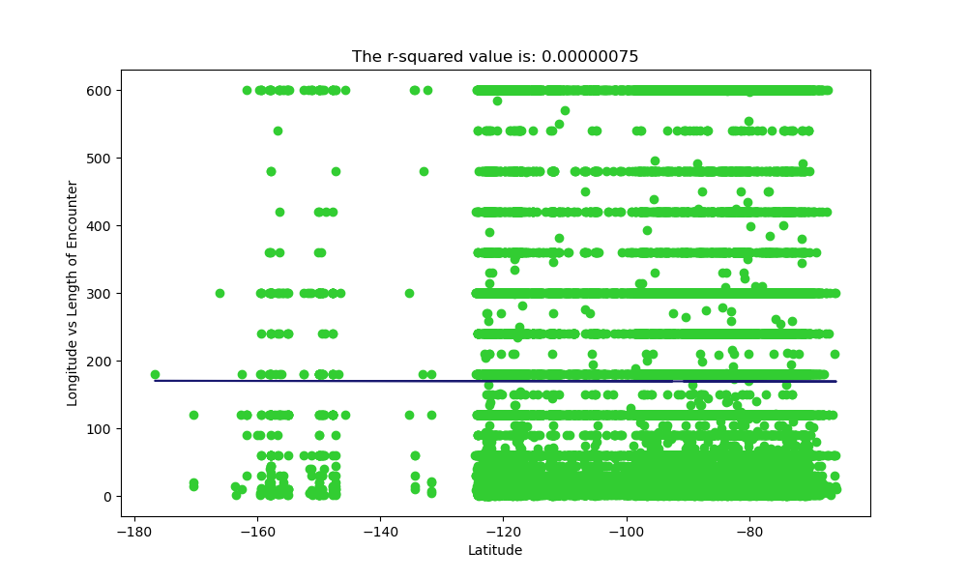

Slide 10
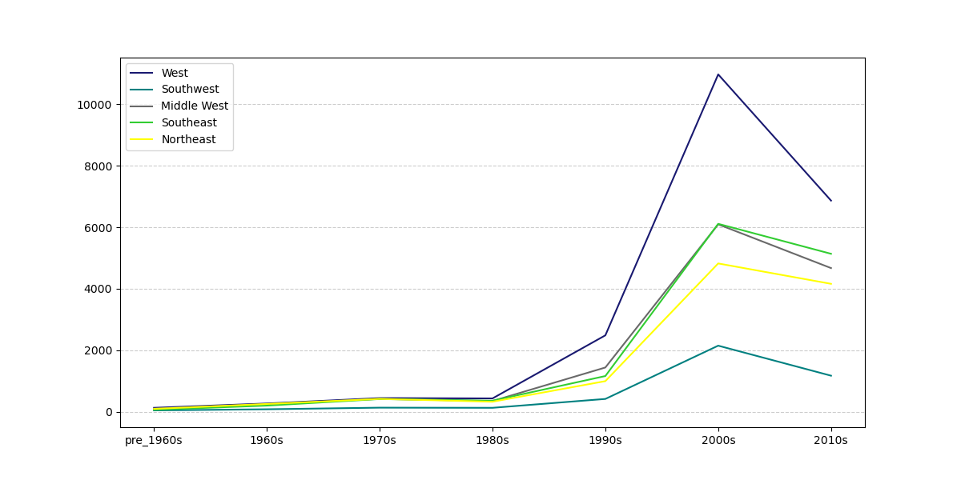

Slide 11
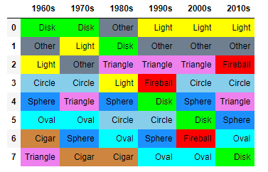

Slide 12
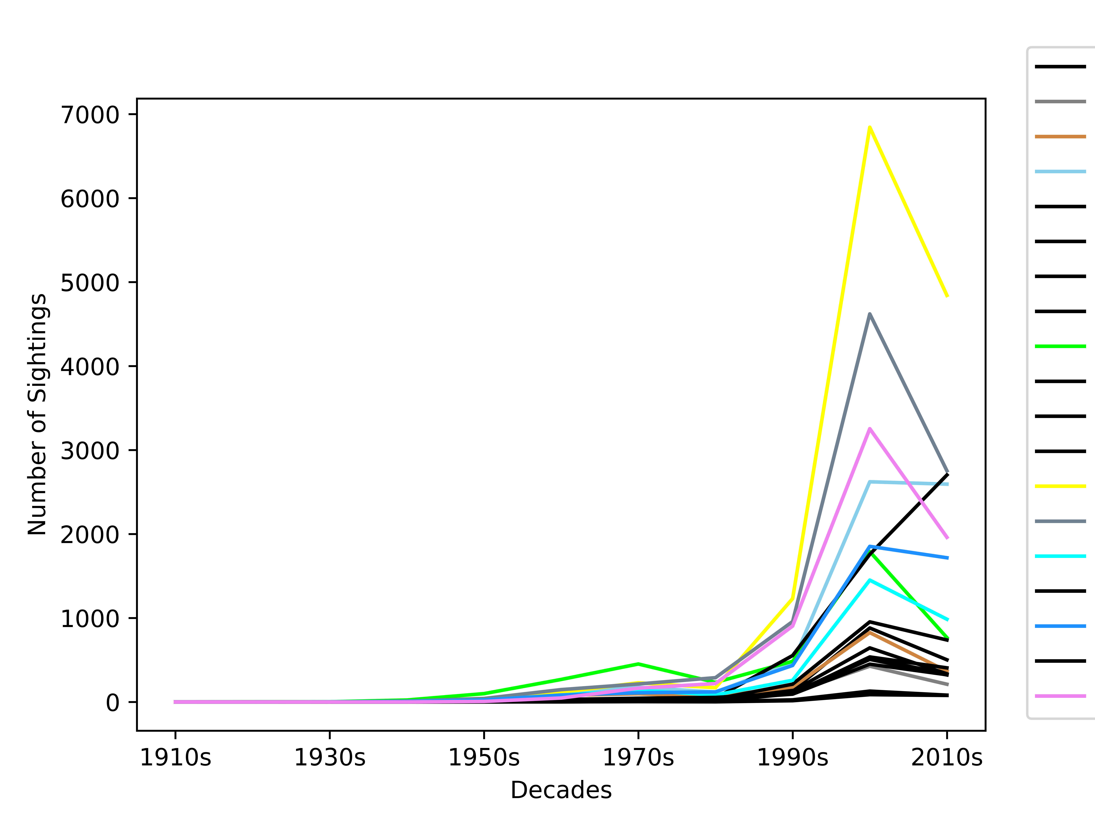

Slide 14
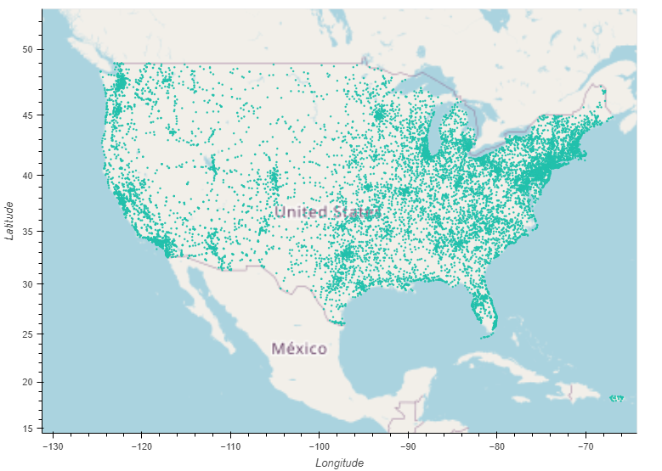
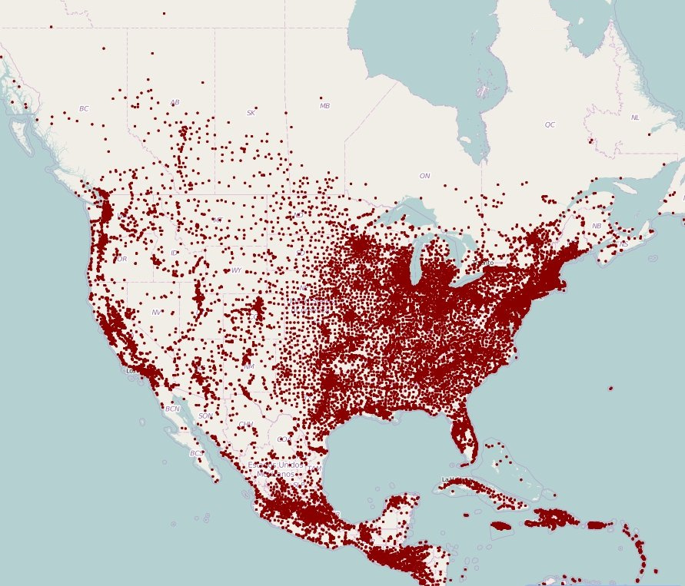
US Encounters: using coordinates of encounters
- cleaned data to look at only US coordinates
- at first glance, it looks like a typical US map showing population density
https://www.visualcapitalist.com/mapping-population-density-dot-town/

Slide 15
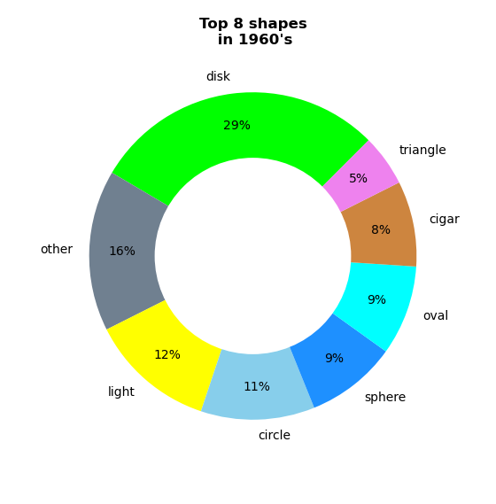
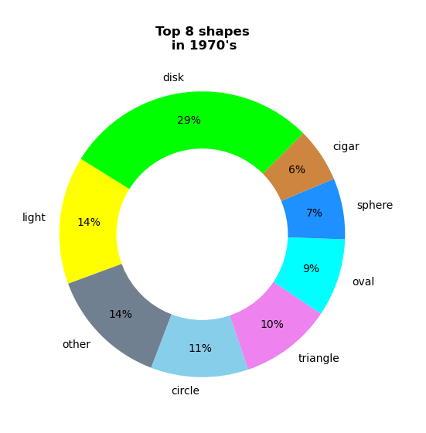
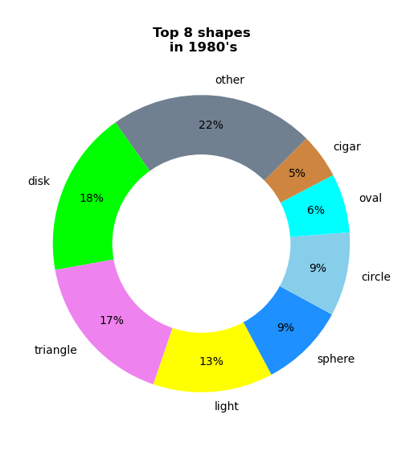
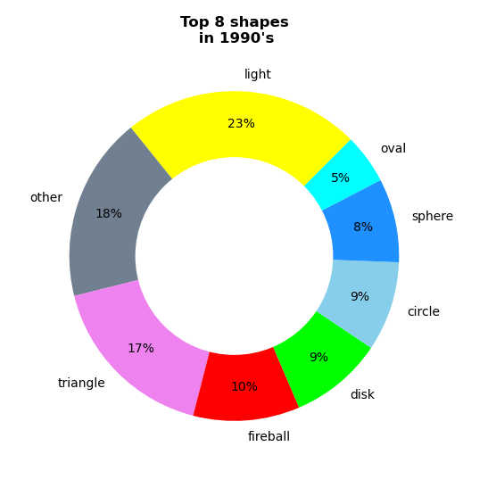
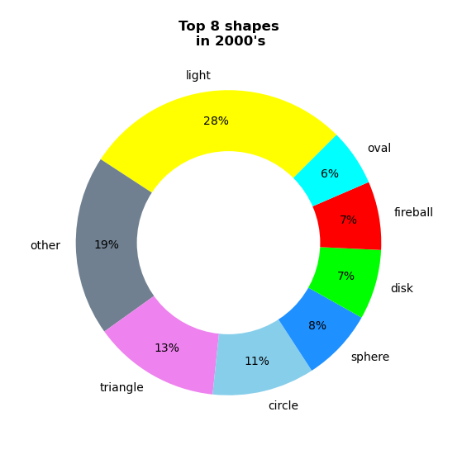
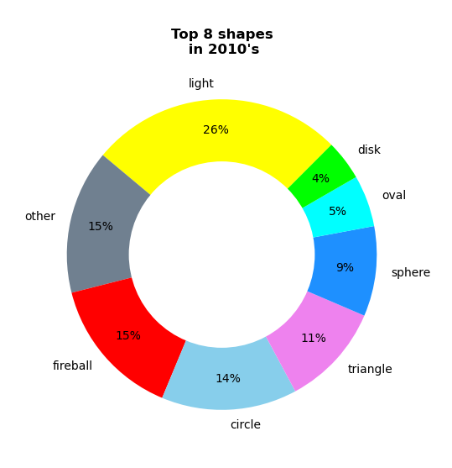
US Encounters: Analysis of the trend of UFO shapes
- used our data to look at the UFO shapes and binning into decades
- saw trends in popularity as 6 shapes were the most popular in 6 decades

Slide 16
US Encounters: Analysis of the trend of UFO shapes
- used our data to look at the UFO shapes and binning into decades
- saw trends in popularity as 6 shapes were the most popular in 6 decades

Slide 17
US Encounters: Analysis of the trend of UFO shapes
- used our data to look at the UFO shapes and binning into decades
- saw trends in popularity as 6 shapes were the most popular in 6 decades

Slide 18
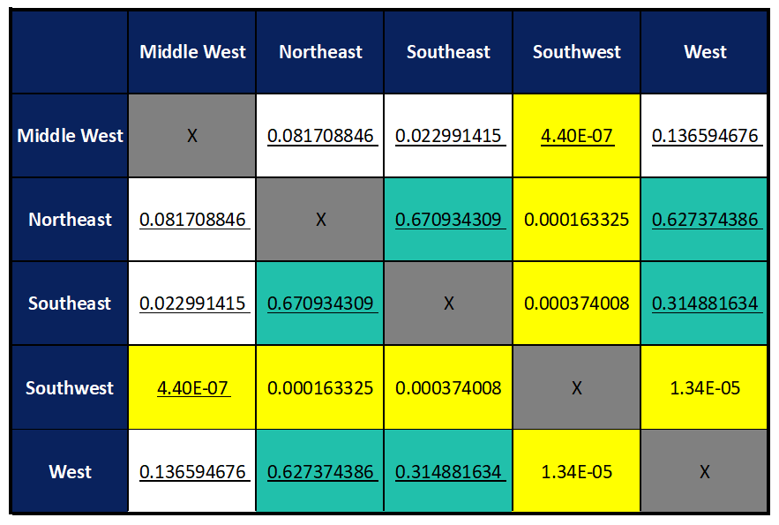
T-testing: using time duration of observation
- we looked at the significant difference between each region with respect to the average length of encounter
- Null Hypothesis: the difference in means for each pair of regions is zero (“the means are the same”)
T-test p-values
- We can reject the null hypothesis of “no difference in mean” and say that the true difference in means is not equal to zero for the pairs highlighted in yellow.
- ie, SW’s average of 154.83 seconds is different than the means in other regions
- Note that the p-values between W, NE, and SE (green) are higher and we can say that the true difference in means IS equal to zero
Means: MW: 173.89 seconds
W: 170.38 seconds
NE: 169.19 seconds
SE: 168.05 seconds
SW: 154.83 seconds

